Slide 1
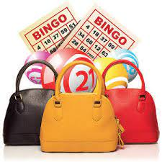
West Milford Highlander Band
Pocketbook Bingo
Mini Tricky Tray
Saturday, April 26, 2025
West Milford High School Cafeteria
Admission Ticket ~ $50.00 per person
Admission includes:
15 games ~ 4 boards per game
1 dauber
1 sheet of tickets for Tricky Tray
Door prize ticket
Dessert and coffee/tea will be served.
Doors open at 5:30 pm ~ Games begin at 6:30 pm
All proceeds will contribute to the purchase
of marching band uniforms.
Bring your own food and beverage.
~ Additional Bingo sheets will be available for purchase ~
Reservations for tables of 8-10 will be held at the door.
Must know the reservation name when checking in.
Please include first and last names of each person attending
on the attached form.
No one under 18 years of age permitted.
Please complete the form attached and return with payment before Friday, April 11, 2024
REVISED

Slide 2
Admission ticket $50.00 per person
West Milford Highlander Band
Pocket Book Bingo
Registration Form
Name: ________________________________________________________
Email:_________________________________________________________
Cell Number: __________________________________________________
I am enclosing $_____________________for ________________tickets.
Cash Check No._______________
Reservation Name for Table:_______________________________________
Names of Guests attending:_______________________________________
______________________________________________________________
______________________________________________________________
______________________________________________________________
______________________________________________________________
Please make checks payable to WMBPA and mail to:
PO BOX 603
West Milford, NJ 07480
Pocket Book Bingo
ATTN: Mary Duffy
Payments due by Friday, April 11, 2025
Questions: contact Mary Duffy ~ wmhighlanderbandparents@gmail.com
REVISED

